Slide 1
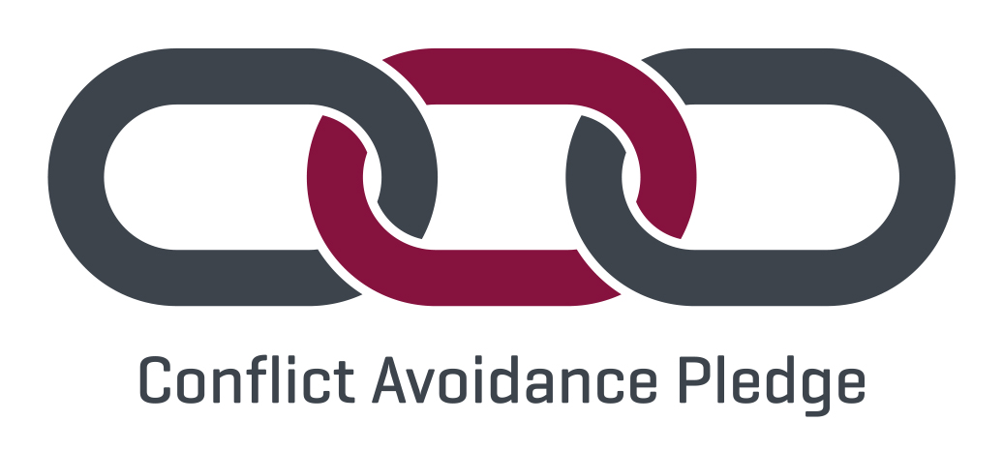
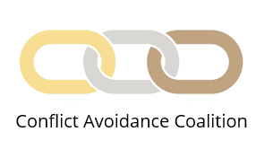
The Pledge:
We commit to working proactively to avoid conflict and to facilitate early resolution of potential disputes.
We believe in collaborative working and the use of early intervention techniques to try to resolve differences of opinion before they escalate into disputes.
We recognise the importance of embedding conflict avoidance mechanisms into projects with the aim of identifying, controlling and managing potential conflict, whilst preventing the need for formal, adversarial dispute resolution procedures. We commit our resources to embedding these into our projects.
We commit to developing our capability in the early identification of potential disputes and in the use of conflict avoidance measures.
We will promote the value of collaborative working to prevent issues from developing into disputes.
We commit to work with our industry partners to identify, promote and utilise conflict avoidance mechanisms.
For more information about the Pledge, see who has signed it to date and to sign up, go to www.rics.org/capledge

